Slide 1




Analysis of bronchoalveolar lavage fluid metatranscriptomes among patients with COVID-19
Michael D Jochum, PhD.
Department of Obstetrics and Gynecology, Division of Maternal-Fetal Medicine, Baylor College of Medicine and Texas Children's Hospital, Houston, TX, USA.
Notes:
Thank you for allowing me to present our ongoing research on behalf of the COVIRT microbial subgroup. I have no conflicts of interest of financial disclosures.

Slide 2
Introduction
Sample Sources -8 different publications
Bronchoalveolar Lavage Fluid (BALF) patients Metatranscriptomes:
Uninfected
Community Acquired Pneumonia (CAP)
COVID19
Deceased
Survived
Objectives
Compare the COVID19 amongst uninfected and CAP patients BALF metatranscriptomes and identify:
Changes in microbial derived community dynamics / gene ontologies associated with COVID19
Predict outcomes amongst COVID19 based on metatranscriptomes profiling
Sample Sources
Chen et al. 2020, NCBI BioProject PRJNA601736
Wu et al. 2020, NCBI BioProject PRJNA603194
Zhou et al. 2020, NCBI BioProject PRJNA605983
Shen et al. 2020, NGDC BioProject PRJCA002202 and NCBI BioProject PRJNA605907
Xiong et al. 2020, NGDC BioProject PRJCA002326
Michalovich et al. 2019, NCBI BioProject PRJNA434133
Ren et al. 2018, NCBI BioProject PRJNA390194
Huang et al. 2019, NCBI BioProject PRJNA484025
Notes:
In order to better understand the potential relationship between COVID-19 disease severity and microbial community dynamics / functional profiles from a hologenome standpoint, *** we conducted an analysis using human bronchoalveolar lavage fluid (BALF) metatranscriptomes sample sequences sourced from 8 different publications that were made available from public repositories.
*** These samples comprise 3 main cohorts case types consisting of uninfected control cohort, community acquired pneumonia or CAP patients, or COVID19 patients, *** with a secondary analysis of disease severity amongst a subset of the COVID19 cohort broken down by survival outcome. *** The objectives of the study are to compare the COVID19 cohort amongst uninfected and CAP patients BALF metatranscriptomes and identify *** Changes in microbial derived community dynamics / gene ontologies associated with COVID19 *** and Predict outcomes amongst COVID19 based on metatranscriptomes profiling ***With the overarching hypothesis that there is a potential informative relationship between the BALF microbiome and the severity of COVID-19 disease onset and progression.
.

Slide 3
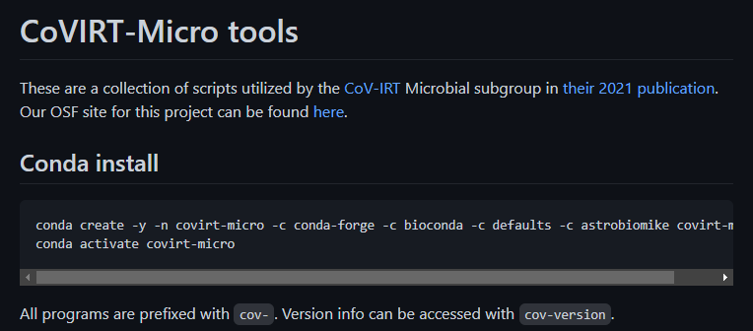
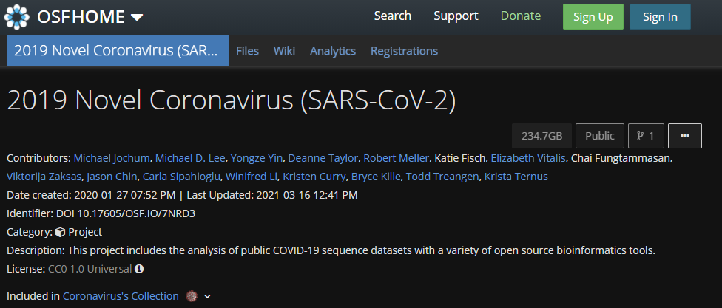
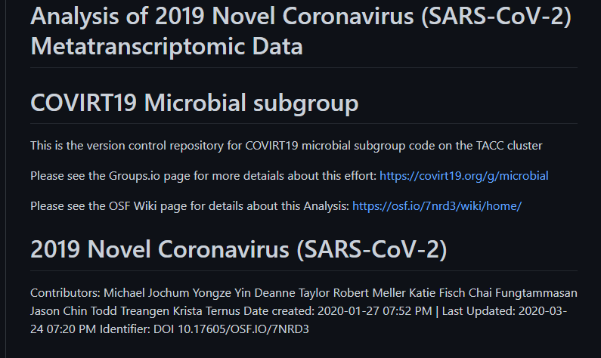
Pipeline
Preprocessing
https://github.com/AstrobioMike/CoV-IRT-Micro
Taxonomy
Gene Ontology
OSF website -https://osf.io/7nrd3/files/
Kraken2
Seqscreen
phyloseq
vegan
metacoder
Dirichlet mixture modeling
https://github.com/COV-IRT/microbial
Maaslin2
Notes:
Raw sequencing reads were download from either SRA or CRA followed by
Read preprocessing consisted of adapter trimming,QA/QC, and filtering of human and low complexity reads using Trimmomatic, fastQC, Kraken2, FastP, followed by
Taxonomic classification via Kraken2 and functional annotation via Seqscreen
Taxonomic classifications were decontaminated against negative controls when applicable using the library decontam in R, followed by statistical analysis and visualization using the bioinformatic software package phyloseq , vegan, and metacoder in R.
Functional annotations gene ontologies counts derived from seqscreen outputs were parent propagated using covirt-micro conda package generated by Mike Lee at NASA.
Parent propagated Gene ontology terms counts were then subjected to a Dirichlet mixture modeling (or Dmm clustering) and comparative analysis using multivariable associations with linear models Maaslin2 in R.
All Scripts, intermediate files, and results can be found in the OSF, and covirt-micro githubs repos and conda packages.

Slide 4
Sample Characteristics
Overview of Meta-analysis dataset Clinical Characteristics n=86
Variable | Uninfected | Community Acquired pneumonia | COVID19
case | 29 (33.72%) | 25 (29.07%) | 32(37.21%)
Sex
female | 4 (18.18%) | 8 (36.36%) | 10 (45.45%)
male | 5 (13.15%) | 11 (28.94%) | 22 (57.89%)
unspecified | 20 (76.92%) | 6(23.07%) | 0 (0%)
Reads
paired | 29 (37.18%) | 25 (32.05%) | 24 (30.77%)
single | 0 (0%) | 0 (0%) | 8 (100%)
unspecified | 0 (0%) | 0 (0%) | 0 (0%)
Publication
Chen | 0 (0%) | 0 (0%) | 2 (100%)
Ren | 9 (100%) | 0 (0%) | 0 (0%)
Shen | 20 (32.79%) | 25 (40.98%) | 16 (40.98%)
Wu | 0 (0%) | 0 (0%) | 1 (100%)
Xiong | 0 (0%) | 0 (0%) | 4 (100%)
Zhou | 0 (0%) | 0 (0%) | 9 (100%)
Numeric, mean ± SD (n)
Age | 53.2 ± 13.3 (n=9) | 51.2 ± 19.8 (n=17) | 47.3 ± 11.5 (n=32)
Temp. °C | - | 38.4 ± 0.91 (n=15) | 38.4 ± 0.715 (n=8)
days after onset | - | 9.07 ± 3.17 (n=14) | 12.05 ± 6.5 (n=41)
COVID19 Sample Characteristics
outcome | n =32
Deceased | 10 (31.25%)
Survived | 15 (46.87%)
Unspecified | 7 (21.88%)
Cough
aggravated | 1 (2.13%)
expectoration | 3 (9.38%)
intermittent | 2 (6.25%)
yes | 6 (18.75%)
Unspecified | 20 (62.5%)
days delayed hospitalization mean ± SD (n) | 5.27 ± 3.29 (n=11)
Notes:
After read filtering and batch effect sample removal, sample cohorts consisted of 29 Uninfected sampled, 25 CAP samples, and 32 COVID19 samples, bringing the total n to 86. ***
Amongst the COVID19 cohort with known survival outcomes, 10 were deceased and 15 were survived.

Slide 5
Notable Gene Ontologies
COVID19 vs uninfected & viral pneumonia
Ontology | Depth 1 Parent(s) | feature | Depth
Molecular Function | GO:0003824 catalytic activity | hydrolase activity | 2
 |  | transferase activity | 2
 |  | transferase activity, transferring phosphorus | 3
 |  | nucleotidyltransferase activity | 4
 | GO:0005488 binding | ion binding | 2
Biological Process | GO:0008152 metabolic process | organic substance metabolic process | 2
 |  | primary metabolic process | 2
 |  | biosynthetic process | 2
 |  | nitrogen compound metabolic process | 2
 |  | macromolecule metabolic process | 3
 |  | organic cyclic compound metabolic process | 3
 |  | organonitrogen compound metabolic process | 3
 |  | heterocycle metabolic process | 3
 | GO:0008152 metabolic process | GO:0009987 cellular process | cellular metabolic process | 2
 |  | cellular nitrogen compound metabolic process | 3
 |  | organic substance biosynthetic process | 3
 |  | cellular biosynthetic process | 3
 |  | cellular macromolecule metabolic process | 4
 | GO:0065007 Biological Regulation | regulation of biological process | 2
 |  | regulation of cellular process | 3
 | GO:0044419 interspecies interaction between organisms | modulation of process of other organism | 2
 |  | symbiotic process | 2
 |  | viral process | 3
 |  | interaction with host | 3
 |  | Mod. of process of other organism in symbiotic interact | 3
 |  | modulation by symbiont of host process | 4
 |  | modulation by virus of host process | 5
 |  | modulation by symbiont of host cellular process | 5
 |  | modulation by virus of host cellular process | 6
Notes:
30 out of a total of 13,534 Gene ontologies were associated with COVID19 when compared to community acquired pneumonia and uninfected patients using a pvalue cutoff of 0.05 with BH mutltiple test correction (Controlling for random effects of publication and patient).
Sig. go terms were comprised of 6 Depth 1 Parents involving catalytic activity, binding, metabolic and cellular processes ,biological regulation, and interspecies interaction between organisms.

Slide 6
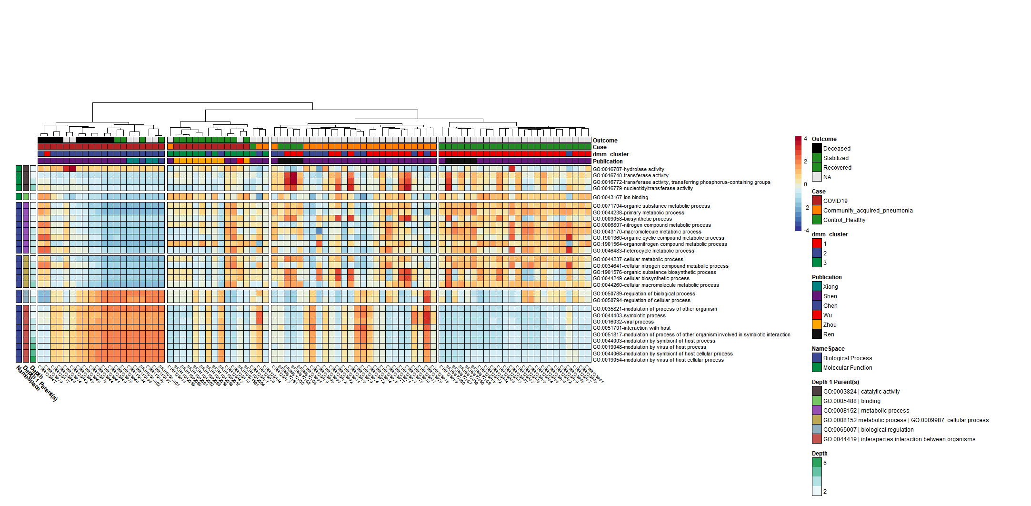
COVID19 vs Uninfected & viral pneumonia
Uninfected
Notes:
Significant Terms of interest associated with COVID19 include hydrolase/transferase activity transferring phosphorus, and nucleotidyltransferase activity, and ion binding.
Additionally, Results from the Dirichlet Multinomial Mixtures clustering analysis using all 13,534 Gene ontologies counts resulted in a best model fit using 3 distinct dmm clusters that were significantly associated with each case type p<0.0001***.
Figure 1. Microbially derived gene ontology functional annotations associated with COVID19. Comparisons were conducted using Maaslin2, controlling for publication and patient with Benjamini Hochber multiple test comparison (q<0.05)

Slide 7
Dirichlet Mixture Modeling
Uninfected
Deceased
Survived
COVID19
Community acquired pneumonia
Uninfected
Dmm cluster 2
Dmm cluster 3
Dmm cluster 1
Notes:
Significant Terms of interest associated with COVID19 include hydrolase/transferase activity transferring phosphorus, and nucleotidyltransferase activity, and ion binding.
Additionally, Results from the Dirichlet Multinomial Mixtures clustering analysis using all 13,534 Gene ontologies counts resulted in a best model fit using 3 distinct dmm clusters that were significantly associated with each case type p<0.0001***.
Figure 1. Microbially derived gene ontology functional annotations associated with COVID19. Comparisons were conducted using Maaslin2, controlling for publication and patient with Benjamini Hochber multiple test comparison (q<0.05)

Slide 8
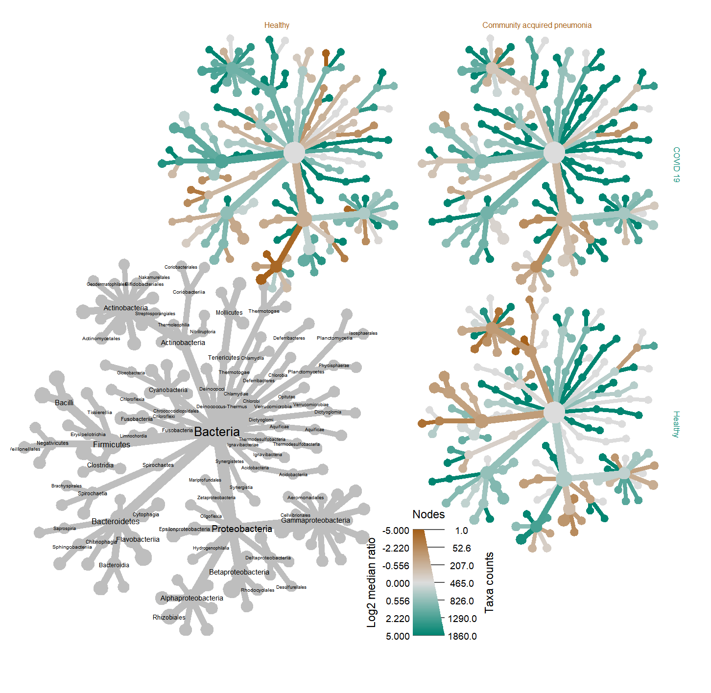
Distinct COVID19 vs Uninfected & viral pneumonia Taxonomic profiles
Community acquired pneumonia
Uninfected
Sphingomonas
treatment | median ratio | p | q
CAP | -2.05 | 0.007 | <0.05 | *
Uninfected | -2.80 | <0.0001 | <0.0005 | ***
COVID19
Uninfected
Sphingomonas
Notes:
Taxonomic analysis revealed a statistically significant decrease in log2 median ration of several species *** belonging to the genus Sphingomonas when compared to both the uninfected (p<0.0001, q <0.001) and CAP cohorts (p<0.005,q <0.05) cohorts (table X). This finding supports previous reports regarding an association with Sphingomonas, which is commonly known as an opportunistic pathogen found in healthcare-associated pneumonia.
Sig. GO Terms derived from Sphingomonas proteins in the COVID19 samples were
hydrogen peroxide catabolic process [GO:0042744];
response to oxidative stress [GO:0006979]
catalase activity [GO:0004096]; heme binding [GO:0020037];
metal ion binding [GO:0046872]
The catalase protein decomposes hydrogen peroxide into water and oxygen; serves to protect cells from the toxic effects of hydrogen peroxide.
So as a discussion point perhaps Sphingomonas is responding to COVID-19 conditions in the patient by expressing genes that help it to survive well under the COVID-19 disease conditions.

Slide 9
Distinct COVID19 vs Uninfected & viral pneumonia Taxonomic profiles
Community acquired pneumonia
Uninfected
Sphingomonas
treatment | median ratio | p | q
CAP | -2.05 | 0.007 | <0.05 | *
Uninfected | -2.80 | <0.0001 | <0.0005 | ***
COVID19
Uninfected
Sphingomonas
Notes:
Taxonomic analysis revealed a statistically significant decrease in log2 median ration of several species *** belonging to the genus Sphingomonas when compared to both the uninfected (p<0.0001, q <0.001) and CAP cohorts (p<0.005,q <0.05) cohorts (table X). This finding supports previous reports regarding an association with Sphingomonas, which is commonly known as an opportunistic pathogen found in healthcare-associated pneumonia.
Sig. GO Terms derived from Sphingomonas proteins in the COVID19 samples were
hydrogen peroxide catabolic process [GO:0042744];
response to oxidative stress [GO:0006979]
catalase activity [GO:0004096]; heme binding [GO:0020037];
metal ion binding [GO:0046872]
The catalase protein decomposes hydrogen peroxide into water and oxygen; serves to protect cells from the toxic effects of hydrogen peroxide.
So as a discussion point perhaps Sphingomonas is responding to COVID-19 conditions in the patient by expressing genes that help it to survive well under the COVID-19 disease conditions.

Slide 10
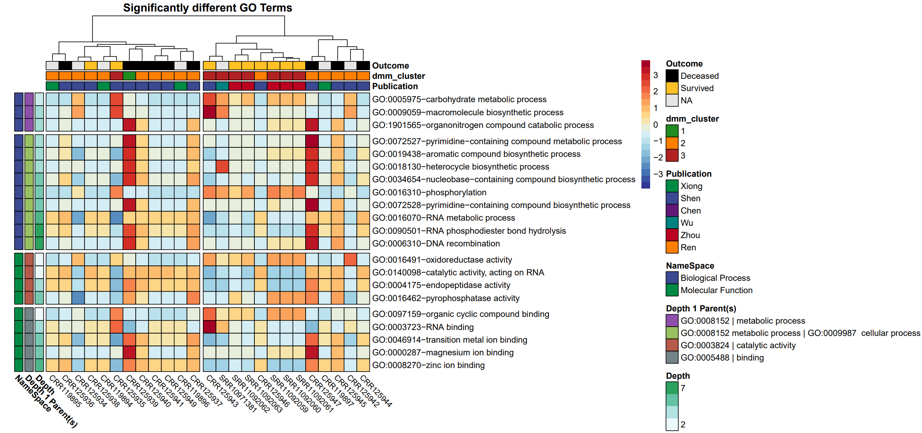
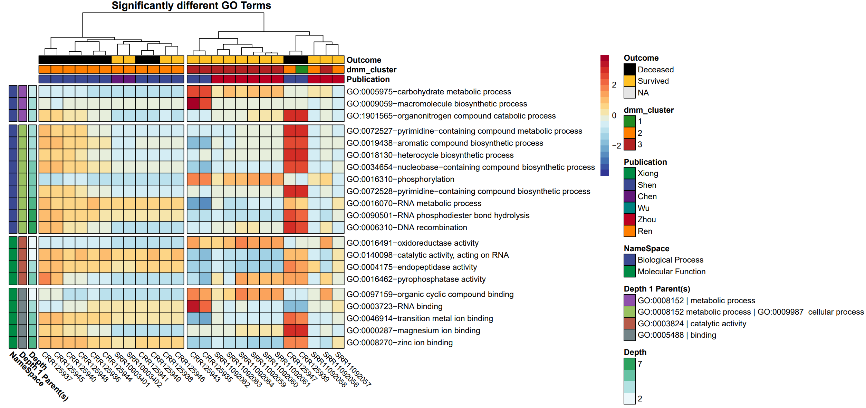
Notable Gene Ontologies COVID19 : Deceased vs Survived
Notes:
Results of an Analysis of Variance of a linear model of *** outcome based and clusters derived from the unsupervised machine learning Dirichlet mixture modeling clustering analysis
revealed a statistically significant associated between dmm_cluster number and outcome with a p value of <0.001 and an Adjusted R-squared value of 0.3238. *** A posthoc Tukey- Kramer multiple comparison of means test with 95% confidence intervals showed a statistically significance amongst samples that deceased compared with samples that survived with an adjusted p value of 0.001.
Pearson's Chi-squared test revealed a statistically significant correlations with dmm cluster and outcome *** DMM cluster here?
Pearson's Chi-squared test
data: tab
X-squared = 12.774, df = 4, p-value = 0.01244

Slide 11
Deceased
Survived
Analysis of Variance (ANOVA) Table of dmm cluster and Disease Outcome
Response: dmm_cluster
Feature | Df | Sum Sq. | Mean Sq. | F value | Pr(>F)
Outcome | 2 | 3.1116 | 1.5558 | 8.4221 | 0.001307 | **
Residuals | 29 | 5.3571 | 0.18473
---
Signif. codes: 0 ‘***’ 0.001 ‘**’ 0.01 ‘*’ 0.05 ‘.’ 0.1 ‘ ’ 1
Tukey multiple comparisons of means
95% family-wise confidence level
comparison | diff | lwr | upr | p adj
NA-Deceased | 0.242857 | -0.28023 | 0.765949 | 0.49393
Survived-Deceased | 0.7 | 0.266662 | 1.133338 | 0.001164 | **
Survived-NA | 0.457143 | -0.02873 | 0.943012 | 0.068285
Notes:
Results of an Analysis of Variance of a linear model of *** outcome based and clusters derived from the unsupervised machine learning Dirichlet mixture modeling clustering analysis
revealed a statistically significant associated between dmm_cluster number and outcome with a p value of <0.001 and an Adjusted R-squared value of 0.3238. *** A posthoc Tukey- Kramer multiple comparison of means test with 95% confidence intervals showed a statistically significance amongst samples that deceased compared with samples that survived with an adjusted p value of 0.001.
Pearson's Chi-squared test revealed a statistically significant correlations with dmm cluster and outcome *** DMM cluster here?
Pearson's Chi-squared test
data: tab
X-squared = 12.774, df = 4, p-value = 0.01244

Slide 12
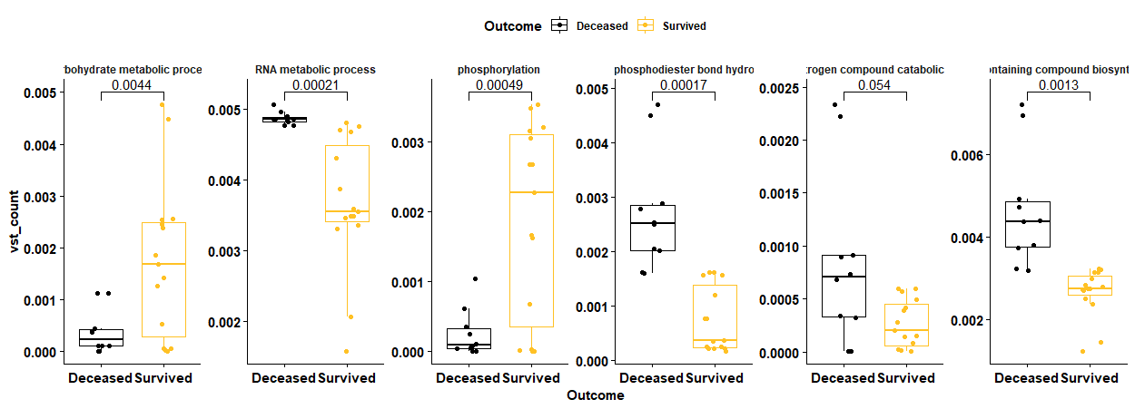
Deceased
Survived
Notes:
Feature of particular interest associated with morbidity in the Depth 1 parent *** Metabolic and cellular processes include decreases in *** carbohydrate metabolic processes,
Increases in *** RNA metabolic processes and RNA phosphodiester bond hydrolysis, *** decreases in phosphorylation, and increases in nucleobase containing compound biosynthetic processes.

Slide 13
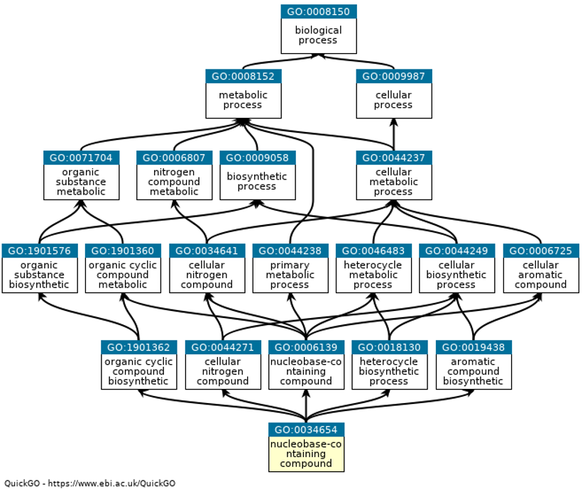
GO Term : Catalytic Activity -Nucleobase-containing compound biosynthetic process

Slide 14
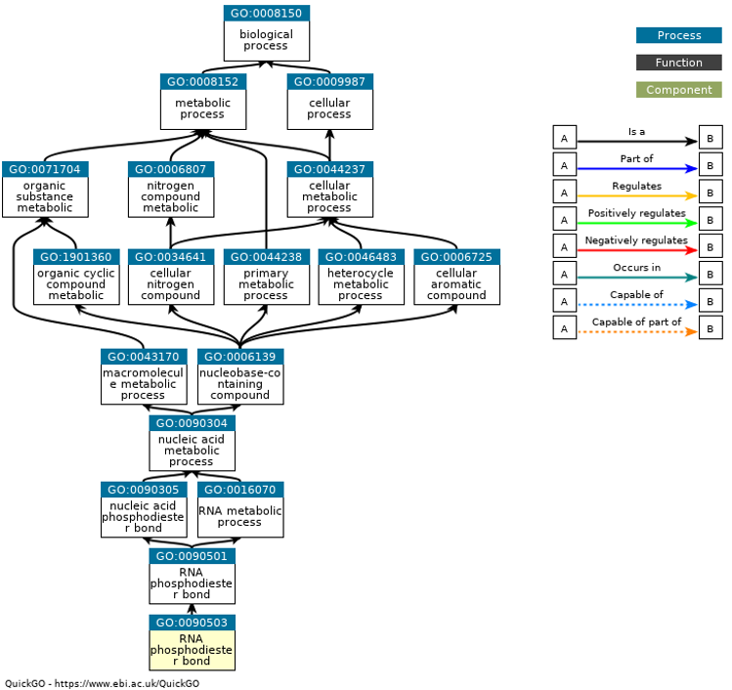
GO Term : Catalytic Activity -RNA phosphodiester bond hydrolysis

Slide 15
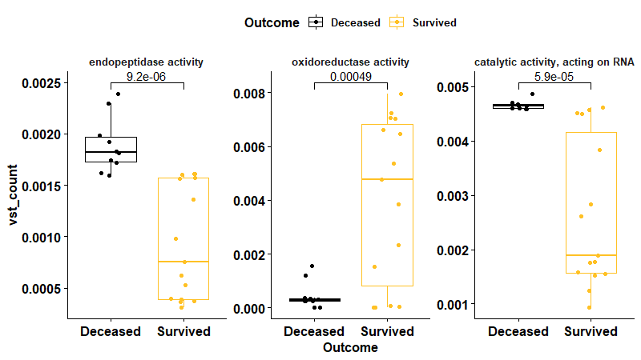
Deceased
Survived
Notes:
Gene ontology comparison amongst those who died.*** Depth 1 parent Catalytic activity Gene ontology comparison amongst those who died to those who survived reported major *** decreases in oxoreductase activity, *** increases in catalytic activity acting on RNA***, and endopeptidase activity***. [NEXT SLIDE]

Slide 16
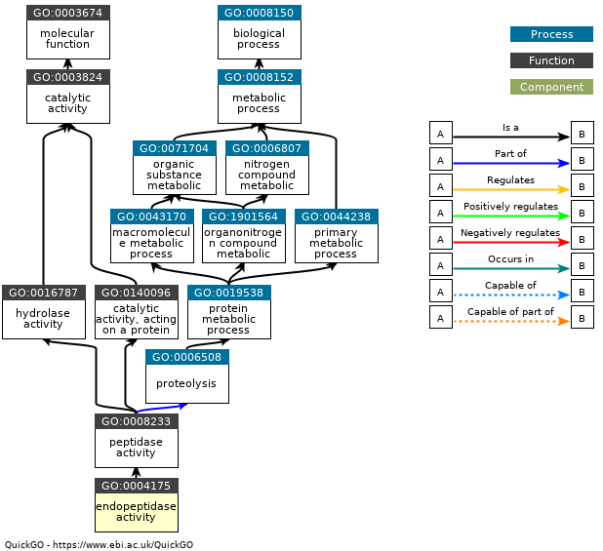
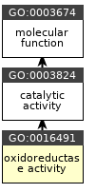
GO Terms : Catalytic Activity

Slide 17
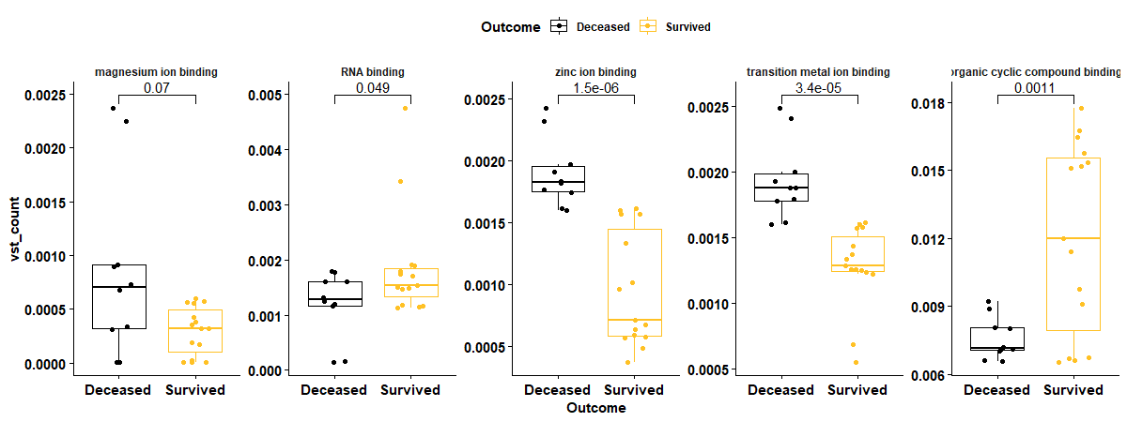
Deceased
Survived
Notes:
Lastly *** with respect to the Go Terms belonging to the Depth 1 parent of binding, we observed *** decreases in organic cyclic compound binding and *** increases in RNA binding *** transition metal ion binding, ***magnesium ion binding,*** and zinc ion binding amongst those who died compared to those who survived. [NEXT SLIDE]

Slide 18
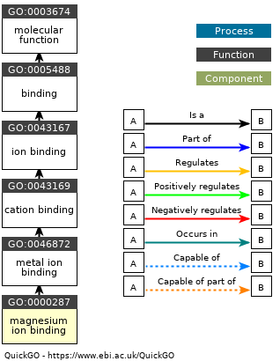
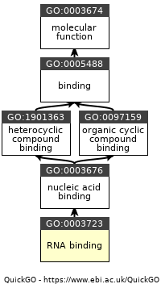
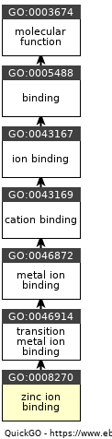
GO Term Depth 1 Parent: Binding

Slide 19
Summary of GO terms:COVID19
GO Terms assoc. w/ COVID19 outcome (Deceased/Survived)
Ontology | Gene ontology nomenclature | coef | stderr | pval | qval | namespace | depth
Biological Process | phosphorylation | 2.897 | 0.888 | <0.001 | 0.036 | GO:0016310 | 3
 | transition metal ion binding | -0.545 | 0.106 | <0.001 | <0.001 | GO:0046914 | 4
 | magnesium ion binding | -2.336 | 0.709 | <0.001 | 0.036 | GO:0000287 | 4
 | nucleobase-containing compound biosynthetic process | -0.63 | 0.117 | <0.001 | <0.001 | GO:0034654 | 5
 | RNA phosphodiester bond hydrolysis | -1.412 | 0.402 | <0.001 | 0.024 | GO:0090501 | 5
 | RNA binding | 0.989 | 0.303 | <0.001 | 0.036 | GO:0003723 | 5
 | RNA metabolic process | -0.31 | 0.086 | <0.001 | 0.018 | GO:0016070 | 7
 | zinc ion binding | -0.88 | 0.266 | <0.001 | 0.036 | GO:0008270 | 7
 | endopeptidase activity | -0.995 | 0.309 | <0.001 | 0.037 | GO:0004175 | 5
Molecular Function | DNA recombination | -2.13 | 0.667 | <0.001 | 0.037 | GO:0006310 | 6
 | pyrophosphatase activity | -0.326 | 0.107 | 0.002 | 0.048 | GO:0016462 | 5
 | oxidoreductase activity | 2.541 | 0.801 | 0.002 | 0.037 | GO:0016491 | 4
 | hydrolase activity, acting on acid anhydrides | -0.323 | 0.107 | 0.003 | 0.052 | GO:0016817 | 3
 | catalytic activity, acting on RNA | -0.546 | 0.174 | 0.002 | 0.039 | GO:0140098 | 2
 | organonitrogen compound catabolic process | -2.388 | 0.721 | <0.001 | 0.036 | GO:1901565 | 5
GO Terms assoc. w/COVID19 vs. uninfected & CAP
Ontology | Depth 1 Parent(s) | feature | namespace | Depth
Molecular Function | GO:0003824 catalytic activity | hydrolase activity | GO:0016787 | 2
 |  | transferase activity | GO:0016740 | 2
 |  | transferase activity, transferring phosphorus | GO:0016772 | 3
 |  | nucleotidyltransferase activity | GO:0016779 | 4
 | GO:0005488 binding | ion binding | GO:0043167 | 2
Notes:
These findings were similar in nature to the GO Terms associated with COVID19 versus the uninfected and community acquired pneumonia patient cohorts

Slide 20
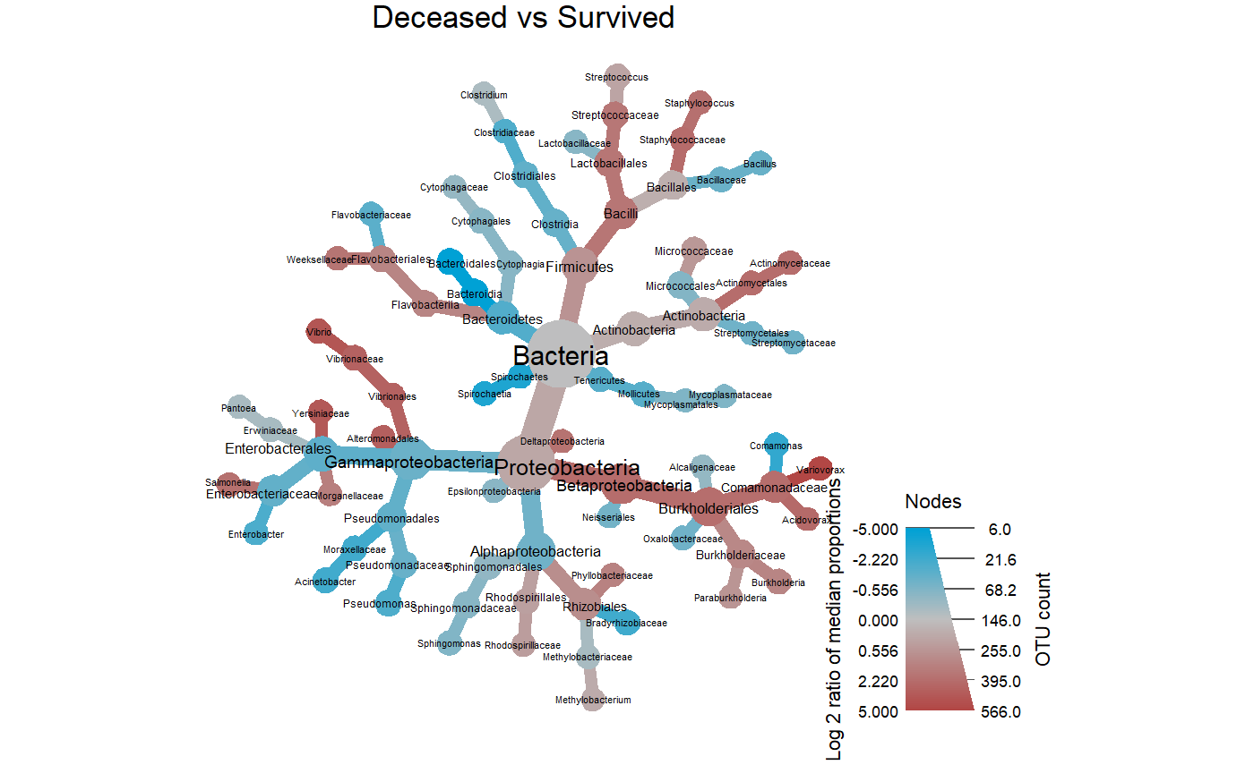
COVID-19 Mortality Taxonomic profiles
Taxonomic comparisons (Deceased vs Survived)
log₂ median ratio | Median diff | Mean diff | p value | q value | Taxonomy
2.25 | 0.361 | 0.371 | 0.00017 | 0.00691 | Comamonadaceae
5.21 | 0.405 | 0.377 | 0.00017 | 0.00691 | Variovorax
2.97 | 0.002 | 0.002 | 0.00353 | 0.074 | Vibrionales
2.97 | 0.002 | 0.002 | 0.00353 | 0.074 | Vibrionaceae
3.8 | 0.002 | 0.00181 | 0.00492 | 0.0827 | Vibrio
1.84 | 0.0549 | 0.13 | 0.0137 | 0.124 | Bacilli
2.24 | 0.403 | 0.297 | 0.0163 | 0.124 | Burkholderiales
3.16 | 0.002 | 0.002 | 0.0157 | 0.124 | Alteromonadales
3.61 | 0.004 | 0.004 | 0.0156 | 0.124 | Yersiniaceae
2.1 | 0.005 | 0.00435 | 0.0156 | 0.124 | Salmonella
1.77 | 0.011 | 0.064 | 0.0475 | 0.274 | Streptococcaceae
2.29 | 0.425 | 0.296 | 0.0264 | 0.185 | Betaproteobacteria
-5.13 | -0.103 | -0.104 | 0.0308 | 0.199 | Bacteroidia
-5.18 | -0.099 | -0.102 | 0.00962 | 0.124 | Bacteroidales
log₂ median ratio | Median diff | Mean diff | p value | q value | Taxonomy
2.25 | 0.361 | 0.371 | 0.00017 | 0.00691 | Comamonadaceae
5.21 | 0.405 | 0.377 | 0.00017 | 0.00691 | Variovorax
2.97 | 0.002 | 0.002 | 0.00353 | 0.074 | Vibrionales
2.97 | 0.002 | 0.002 | 0.00353 | 0.074 | Vibrionaceae
3.8 | 0.002 | 0.00181 | 0.00492 | 0.0827 | Vibrio
1.84 | 0.0549 | 0.13 | 0.0137 | 0.124 | Bacilli
2.24 | 0.403 | 0.297 | 0.0163 | 0.124 | Burkholderiales
3.16 | 0.002 | 0.002 | 0.0157 | 0.124 | Alteromonadales
3.61 | 0.004 | 0.004 | 0.0156 | 0.124 | Yersiniaceae
2.1 | 0.005 | 0.00435 | 0.0156 | 0.124 | Salmonella
1.77 | 0.011 | 0.064 | 0.0475 | 0.274 | Streptococcaceae
2.29 | 0.425 | 0.296 | 0.0264 | 0.185 | Betaproteobacteria
-5.13 | -0.103 | -0.104 | 0.0308 | 0.199 | Bacteroidia
-5.18 | -0.099 | -0.102 | 0.00962 | 0.124 | Bacteroidales
log₂ median ratio | Median diff | Mean diff | p value | q value | Taxonomy
2.25 | 0.361 | 0.371 | 0.00017 | 0.00691 | Comamonadaceae
5.21 | 0.405 | 0.377 | 0.00017 | 0.00691 | Variovorax
2.97 | 0.002 | 0.002 | 0.00353 | 0.074 | Vibrionales
2.97 | 0.002 | 0.002 | 0.00353 | 0.074 | Vibrionaceae
3.8 | 0.002 | 0.00181 | 0.00492 | 0.0827 | Vibrio
1.84 | 0.0549 | 0.13 | 0.0137 | 0.124 | Bacilli
2.24 | 0.403 | 0.297 | 0.0163 | 0.124 | Burkholderiales
3.16 | 0.002 | 0.002 | 0.0157 | 0.124 | Alteromonadales
3.61 | 0.004 | 0.004 | 0.0156 | 0.124 | Yersiniaceae
2.1 | 0.005 | 0.00435 | 0.0156 | 0.124 | Salmonella
1.77 | 0.011 | 0.064 | 0.0475 | 0.274 | Streptococcaceae
2.29 | 0.425 | 0.296 | 0.0264 | 0.185 | Betaproteobacteria
-5.13 | -0.103 | -0.104 | 0.0308 | 0.199 | Bacteroidia
-5.18 | -0.099 | -0.102 | 0.00962 | 0.124 | Bacteroidales
Log2 ratio of median proportions
Read Count
Comparisons were conducted using Wilcoxon rank sum test and adjusted for multiple test comparisons using the benajmini hochberg correction method
Notes:
Survivors of COVID19 moderate to severe disease had a significantly unique BALF metatransciptome profile with notable decreases in the log2 median ratios in the *** Family Comamonadaceae genus Variovorax and
Additionally, thee wer significant increases in the log2 median ratios of order Bacteroidia and class Bacteroidales
https://www.medrxiv.org/content/10.1101/2020.08.20.20144014v1.full.pdf
Notably, Variovorax account for a very high proportion in 6 patients. Interestingly, Staphylococcus xylosus and
https://www.nature.com/articles/s42003-021-01796-w
Staphylococcus simulans had high abundances in three healthy controls (H21, H22 and H23)

Slide 21
Conclusions
There are unique and discriminant features in the BALF metatranscriptomes of:
COVID19 as compared to amongst uninfected and CAP
COVID19 outcome (Survival vs deceased).
Gene ontologies of interest :
Phosphate / phosphorylation
Metal ion binding (mg,zn,etc)
Nucleotide terms (DNA/RNA)
Lytic activity (hydrolase, endopeptidase,etc)
Taxonomic features of interest:
Sphingomonadacea
Sphingomonas
Comamonadaceae
Variovorax
Bacteroidia
Bacteroidales
Notes:
In conclusion, we observed unique and taxonomic and functional discriminant features in the brochoalveolar lavage metatranscriptomes associated with COVID19 disease and death. Taxa of interested included genera from the Sphingomonadacae Class, and function annotated Gene ontologies of interest included associated with:Phosphate / phosphorylation, metal ion binding (mg,zn,etc), nucleotide terms (DNA/RNA), Lytic activity (hydrolase, endopeptidase,etc)

Slide 22
COV-IRT Microbial Subgroup Team Members
Signature Science, LLC
Dr. Krista Ternus
NASA
Dr. Mike Lee
Dr. Cassie Conley
Baylor College of Medicine
Dr. Michael Jochum
Dr. Kjersti Marie Aagaard
Georgia Institute of Technology
Dr. Dan Cornforth
Britt Ross
Dr. Marvin Whiteley
University of Chicago
Viktorija Zaksas
Inscripta
Elizabeth Vitalis
Rice University
Kristen Curry
Bryce Kille
Carla Sipahioglu
Winnie Li
Dr. Todd Treangen
TACC
John Fonner

Slide 23









Acknowledgements
Notes:
"The project described was supported by Grant Number T32 HD098069 from NIH NICHD”

Slide 24
Supplementary
Notes:
Sample Sources- The original sequences analyzed in this project were obtained from public repositories, and their sample identifiers were retained in the downstream outputs. For more information about the samples, please see and cite the appropriate original studies.

Slide 25
Comamonadaceae

Slide 26
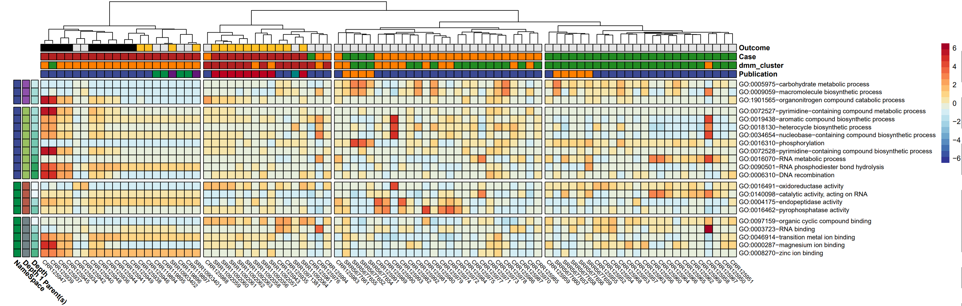

Slide 27
How to I get the NA columns too @Mike Lee

Slide 28
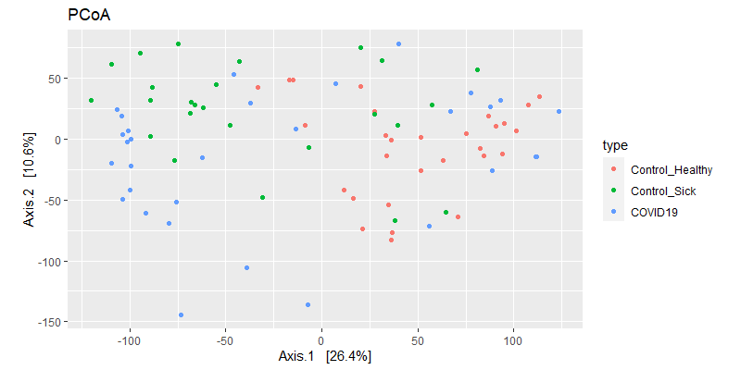
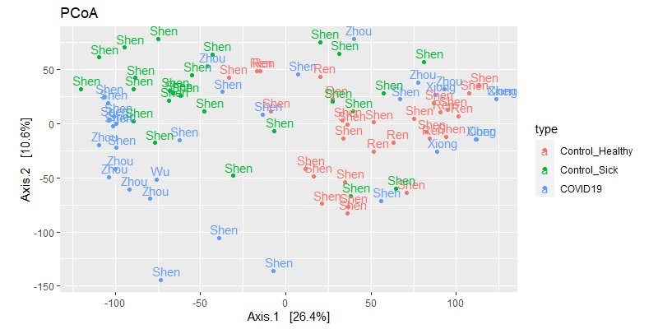
Diversity metrics (case)

Slide 29
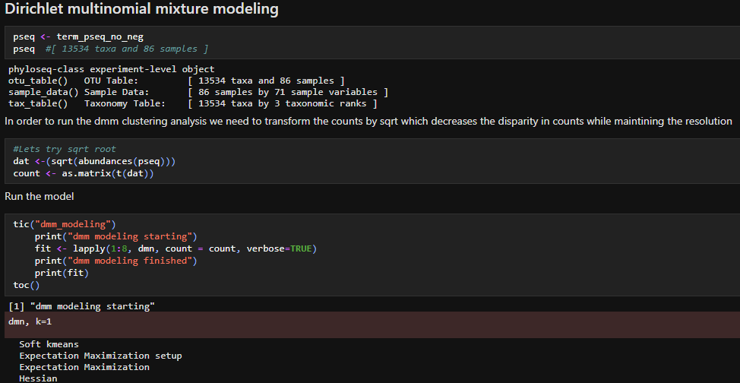
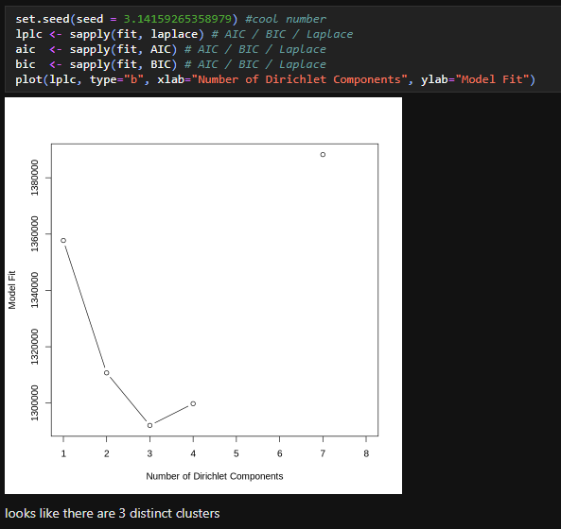
Notes:
Sample Sources- The original sequences analyzed in this project were obtained from public repositories, and their sample identifiers were retained in the downstream outputs. For more information about the samples, please see and cite the appropriate original studies.

Slide 30
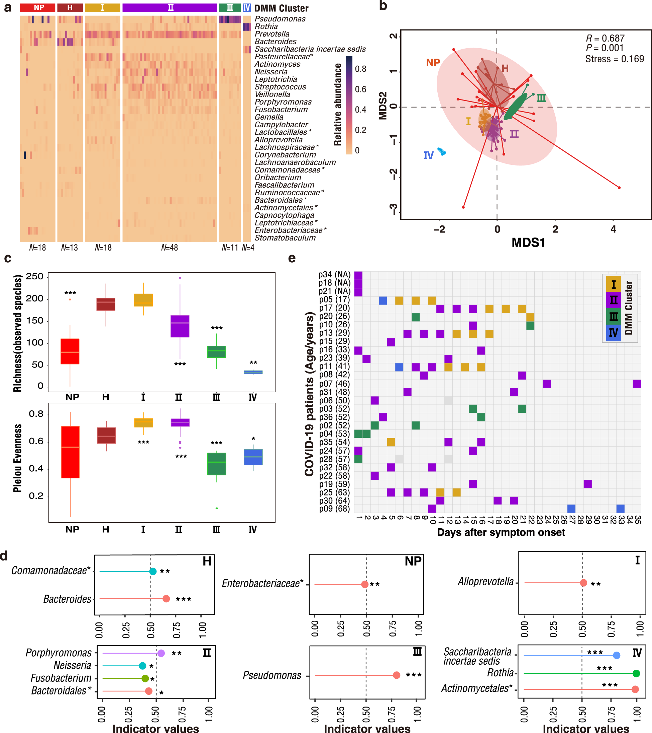
COVID-19 Mortality Taxonomic profiles
Notes:
Survivors of COVID19 moderate to severe disease had a significantly unique BALF metatransciptome profile with notable GO Terms
https://www.medrxiv.org/content/10.1101/2020.08.20.20144014v1.full.pdf
Notably, Variovorax account for a very high proportion in 6 patients. Interestingly, Staphylococcus xylosus and
https://www.nature.com/articles/s42003-021-01796-w
Staphylococcus simulans had high abundances in three healthy controls (H21, H22 and H23)
https://www.cell.com/cell-reports/pdfExtended/S2211-1247(21)00447-2
Stimulator of interferon genes (STING) regulates immune responses to bacteria and viruses by responding to cyclic dinucleotides (CDNs), including the endogenous STING ligand 20 30 -cyclic GMP-AMP (cGAMP) that is produced by cyclic GMP-AMP synthase (cGAS) (Sun et al., 2013). Bacteria also produce STING-activating CDNs, including c-di-GMP, c-di-AMP, and 30 30 -cGAMP (Davies et al., 2012). Humans and mice with gain-of-function mutations in STING develop spontaneous inflammation in the lungs, hypercytokinemia, and T cell cytopenia (Liu et al., 2014; Warner et al., 2017). Because STING gain-of-function mutants may exhibit enhanced ligand sensitivity (Liu et al., 2014), we reasoned that CDNs produced by commensal bacteria might regulate autoimmune lung disease pathogenesis in a mouse model of

Slide 31
Possible correlations
So After a quick google scholar search of the term COVID19, “transferase”, “phosphate”, ”adenyl”, and “nucleotide” the following articles continued to pop up.
Notes:
Sample Sources- The original sequences analyzed in this project were obtained from public repositories, and their sample identifiers were retained in the downstream outputs. For more information about the samples, please see and cite the appropriate original studies.

Slide 32
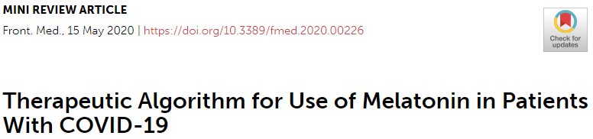
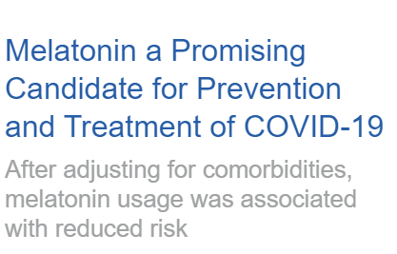
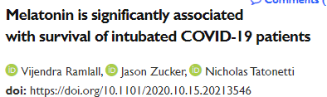
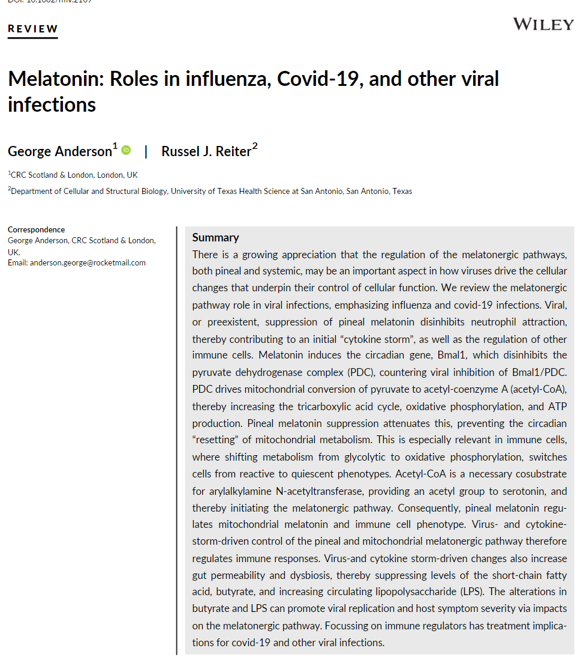
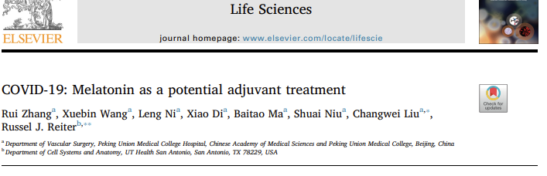
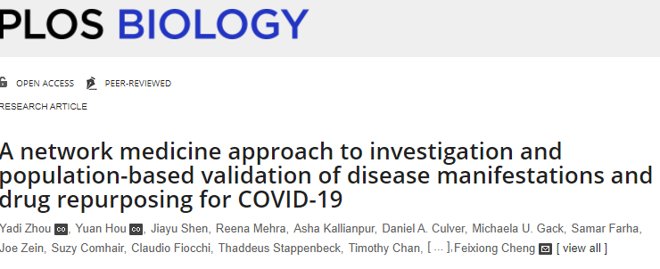
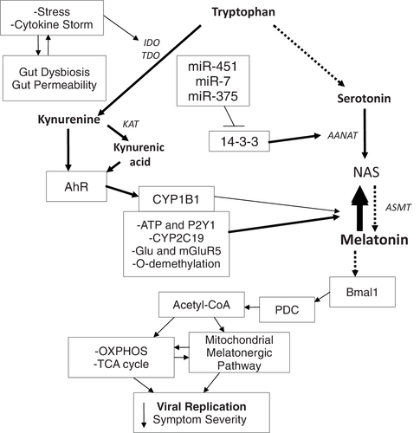
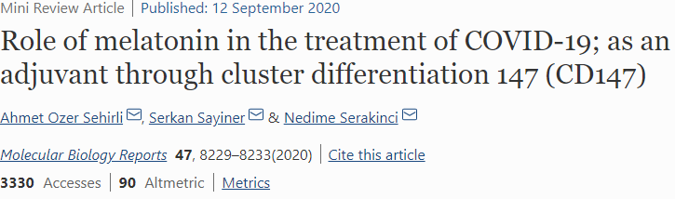
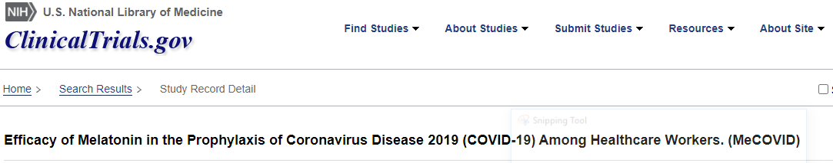
Virus& cytokine‐storm‐driven control of pineal and mitochondrial melatonergic pathway regulates immune responses
Viral, or preexistent, suppression of pineal melatonin disinhibits neutrophil attraction, thereby contributing to an initial “cytokine storm”, as well as the regulation of other immune cells.
Melatonin induces Bmal1 which disinhibits the PDC, countering viral inhibition of Bmal1/PDC.
Acetyl‐CoA is essential cosubstrate for arylalkylamine N‐acetyltransferase, providing an acetyl group to serotonin, and thereby initiating the melatonergic pathway.
Consequently, pineal melatonin regulates mitochondrial melatonin and immune cell phenotype.
Possible treatment implications for COVID‐19
Notes:
FIGURE 1Open in figure viewerPowerPoint
The cytokine storm and stress can increase gut dysbiosis/permeability, further contributing to cytokine induced IDO and TDO, leading to kynurenine and kynurenic acid, which activate the AhR to increase CYP1B1 and regulate the NAS/Melatonin ratio. Other factors, including CYP2C19, mGluR5, P2Y1, and O‐demethylation can also regulate the NAS/melatonin ratio. The miRNAs, miR‐7, miR‐375, and miR‐451 are increased following many viral infections, thereby suppressing 14‐3‐3 and the stabilization of AANAT, leading to melatonergic pathway inhibition. The suppression of melatonin, including from an increase in the NAS/melatonin ratio, attenuates melatonin's induction of Bmal1 and therefore the circadian regulation of mitochondria. Bmal1 induces PDC, leading to an increase in OXPHOS, the TCA cycle and the acetyl‐CoA that is a necessary co‐substrate for AANAT and melatonergic pathway activation. The decrease in pineal and mitochondrial melatonin contributes to an increase in the replication and severity of many viral infections. The arrows indicate “stimulation”, with a crossed‐line indicating “inhibitory”
https://onlinelibrary.wiley.com/doi/full/10.1002/rmv.2109#:~:text=Melatonin%20is%20actively%20inhibited%20by,associated%20with%20viral%E2%80%90linked%20fatality.
Viral, or preexistent, suppression of pineal melatonin disinhibits neutrophil attraction, thereby contributing to an initial “cytokine storm”, as well as the regulation of other immune cells.
Melatonin induces the circadian gene Bmal1 which disinhibits the PDC, countering viral inhibition of Bmal1/PDC.
PDC drives mitochondrial conversion of pyruvate to acetyl‐coenzyme A (acetyl‐CoA), thereby increasing the tricarboxylic acid cycle, oxidative phosphorylation, and ATP production.
Pineal melatonin suppression attenuates this, preventing the circadian “resetting” of mitochondrial metabolism.
This is important in immune cells shifting glycolytic to oxidative phosphorylation metabolism which switches cells from reactive to quiescent.
Acetyl‐CoA cosubstrate for arylalkylamine N‐acetyltransferase, providing an acetyl group to serotonin, and thereby initiating the melatonergic pathway.
Consequently, pineal melatonin regulates mitochondrial melatonin and immune cell phenotype.
Virus‐and cytokine storm‐driven changes also increase gut permeability and dysbiosis, thereby suppressing levels of the short‐chain fatty acid, butyrate, and increasing circulating lipopolysaccharide (LPS).
The alterations in butyrate and LPS can promote viral replication and host symptom severity via impacts on the melatonergic pathway.
Possible treatment implications for covid‐19 and other viral infections.
Also cd147 hypothesis
CD147 protein and the potential protective effect of melatonin that is mediated by this protein in COVID-19. CD147 is a glycoprotein that is responsible for the cytokine storm in the lungs through the mediation of viral invasion. Melatonin use previously was shown to reduce cardiac damage by blocking the CD147 activity.

Slide 33
Possible Viral mechanistic correlations

Slide 34
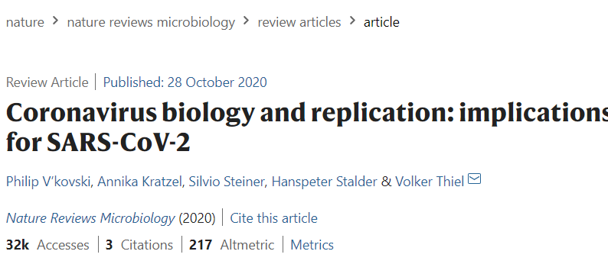
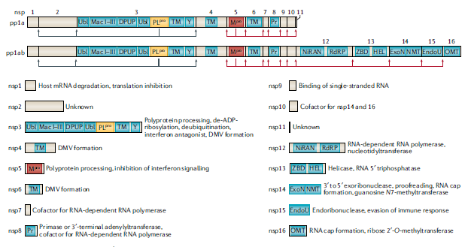
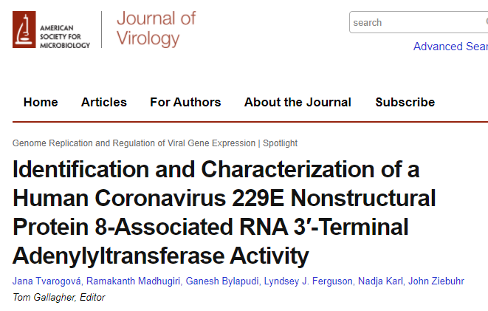
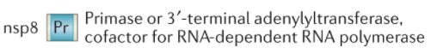
Possible orf8 relationship
RNA synthesis is performed by the nsp12 RNA- dependent RNA polymerase (RdRP) and its two cofactors nsp7 and nsp8, the latter with proposed primase or 3′- terminal adenylyltransferase
found that the protein has metal ion-dependent RNA 3′-terminal adenylyltransferase (TATase) activity while other nucleotides were not (or very inefficiently) transferred to the 3′ ends of single-stranded and (fully) double-stranded acceptor RNAs.
Possible that nsp8-mediated TATase activity is involved in the 3′ polyadenylation of viral plus-strand RNAs. (unconfirmed)
Notes:
https://www.cell.com/structure/fulltext/S0969-2126(05)00313-8?_returnURL=https%3A%2F%2Flinkinghub.elsevier.com%2Fretrieve%2Fpii%2FS0969212605003138%3Fshowall%3Dtrue
https://onlinelibrary.wiley.com/doi/10.1002/jmv.25719
https://www.ncbi.nlm.nih.gov/pmc/articles/PMC7103355/

Slide 35
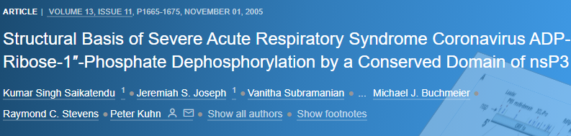
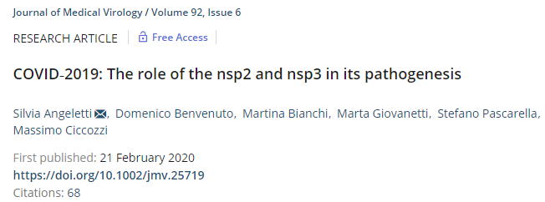
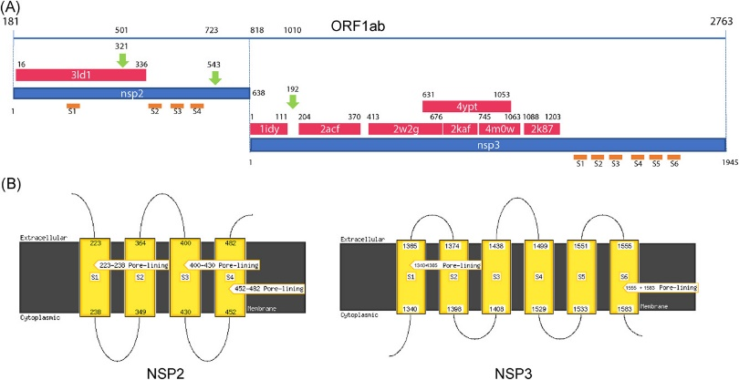
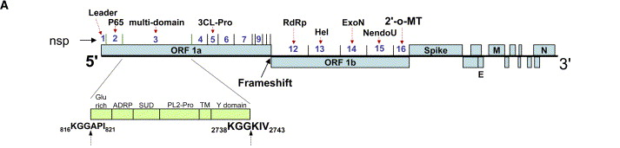
The crystal structure of a conserved domain of nonstructural protein 3 (nsP3) from severe acute respiratory syndrome coronavirus (SARS-CoV) The putative active site is a solvent-exposed
three structural homologs,
yeast Ymx7,
Archeoglobus fulgidus AF1521,
Er58 from E. coli.
Homologs acts on ADP-ribose-1″-phosphate (Appr-1″-p).
The SARS nsP3 domain readily removes the 1″ phosphate group from Appr-1″-p in in vitro assays, confirming its phosphatase activity.
Sequence and structure comparison suggests that proteins of this superfamily form an emerging group of nucleotide phosphatases that dephosphorylate Appr-1″-p.
“Destabilizing mutation of nsp3 protein could explain the difference observed between SARS and COVID‐19.”
https://onlinelibrary.wiley.com/doi/10.1002/jmv.25719
https://www.cell.com/structure/fulltext/S0969-2126(05)00313-8?_returnURL=https%3A%2F%2Flinkinghub.elsevier.com%2Fretrieve%2Fpii%2FS0969212605003138%3Fshowall%3Dtrue
Notes:
https://www.cell.com/structure/fulltext/S0969-2126(05)00313-8?_returnURL=https%3A%2F%2Flinkinghub.elsevier.com%2Fretrieve%2Fpii%2FS0969212605003138%3Fshowall%3Dtrue
https://onlinelibrary.wiley.com/doi/10.1002/jmv.25719
The crystal structure of a conserved domain of nonstructural protein 3 (nsP3) from severe acute respiratory syndrome coronavirus (SARS-CoV) has been solved by single-wavelength anomalous dispersion to 1.4 A resolution. The structure of this "X" domain, seen in many single-stranded RNA viruses, reveals a three-layered alpha/beta/alpha core with a macro-H2A-like fold. The putative active site is a solvent-exposed cleft that is conserved in its three structural homologs, yeast Ymx7, Archeoglobus fulgidus AF1521, and Er58 from E. coli. Its sequence is similar to yeast YBR022W (also known as Poa1P), a known phosphatase that acts on ADP-ribose-1''-phosphate (Appr-1''-p). The SARS nsP3 domain readily removes the 1'' phosphate group from Appr-1''-p in in vitro assays, confirming its phosphatase activity. Sequence and structure comparison of all known macro-H2A domains combined with available functional data suggests that proteins of this superfamily form an emerging group of nucleotide phosphatases that dephosphorylate Appr-1''-p.

